Slide 1
Gene therapy progress and prospects cancer

Slide 2
Gene Therapy
Primary challenge for gene therapy
Successfully delivery an efficacious dose of a therapeutic gene to the disease tissue.
Will the delivery systems return to the early clinical trials by ex vivo gene therapy or will there is still be a high demand for systemic therapy?
Will systemic therapy continue to depend on viral vectors, or will non-viral and nanoparticles become the new mode for gene delivery?
The future successes of gene therapy will be built on the improvements in other fields, such as medical devices, cell therapies, protein therapies and nanoparticle technologies.

Slide 3
Cell therapies
The role of cell therapies in the form of stem cell therapies offers enormous potential for impacting human disease.
A more fundamental understanding of the biology of the stem cell growth and differentiation will be required.
A second challenge would be to better understand the regulation of the signal transduction pathways.

Slide 4
Gene therapy is a gene or gene product that can be selectively delivered to a specific cell tissue with minimal toxicity.

Slide 5
Last five years of gene therapy
Gene therapy: Through a series of successes and failures
Over 3,000 patients treated with gene therapy
There has been minimal toxicity associated with gene therapy that could not be treated with a non-steroidal analgesic.
Unfortunately,
one patient has died from a high adenovirus load to his liver
Two children have developed abnormal white blood cell growth from bone marrow stem cells transduced with a retrovirus vector

Slide 6
Other facts and figures
The first successful treatment of a human disease by ex vivo gene replacement therapy was the treatment of X-linked Severe Combined Immunodeficiency (X-SCID)
There is now evidence that there was retroviral integration at chromosome 11p13 in the LMO2 region. This may have lead to overexpression of a pre-oncogene in T cells leading to lymphoproliferation (leukemia).
Most of the approved European and United States gene therapy protocols are for cancer (~66%), in contrast to monogenetic diseases (~11%) and cardiovascular diseases (~8%). The focus of cancer gene therapy has been inmelanoma, prostrate, ovarian and leukemia

Slide 7
Challenges in cancer Gene therapy
There are four issues to be solved before cancer gene therapy will be successful:
Identification of key target genes critical for the disease pathology and progression.
Identifying the correct therapeutic gene to inhibit disease progression.
Optimal trans-gene expression for suppressing the target gene.
Delivery of therapeutic product to the target tissue at an efficacious dose.

Slide 8
Gene therapy: cell delivery
Advantages of cell delivery of therapeutic products are significant:
Minimal immuneresponse
Tissue directed therapy
Selectivity and improved potency of the product that has not been achieved with previous gene delivery methods.
The challenges in cell delivery
1. Determining optimal transduction of cells with a trans gene or product.
2. Gene-transformed cells will require a selective growth advantage over defective cells to repopulate the host.
3. DNA repair genes (minimizes mutations in the gene transformed cells).
4. Genomic stability (for optimal gene expression)?
5. Determining cell type for therapy, embryonic, stem cells or activated differentiated cells?
6. Incorporating a safety mechanism if a problem arises to destroy the gene-transformed cells (i.e. a suicide gene)

Slide 11
Oncolytic virus
Cancer-selective oncolytic viruses replicate preferentially in cancer cells and as a result, destroy those cells at the end of replication cycles;normal cells are spared and hence toxicity is limited

Slide 12
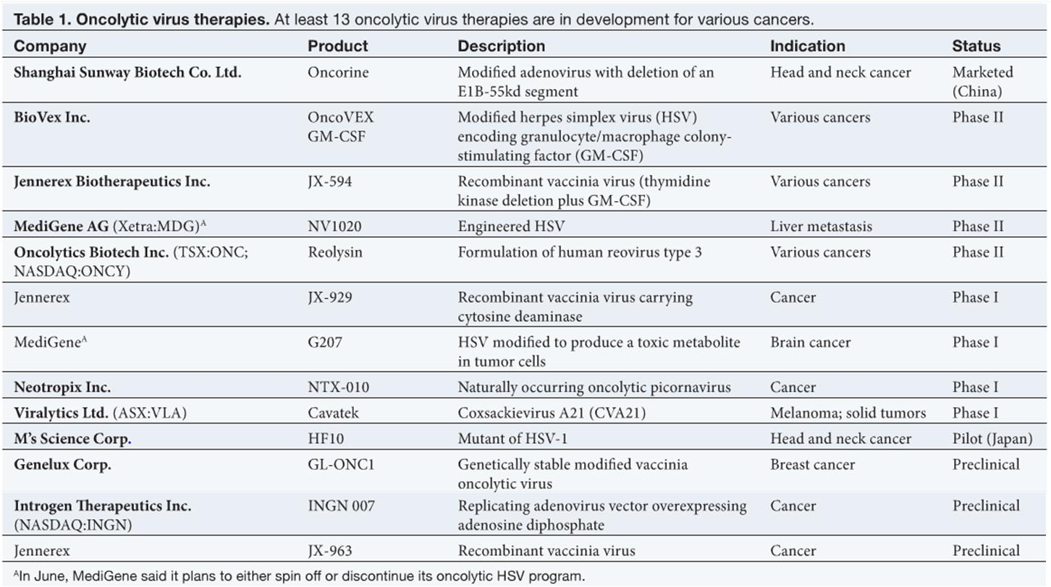
Oncolytic Virus therapy
http://www.nbglobe.com/tag/oncolytic-virus/

Slide 13
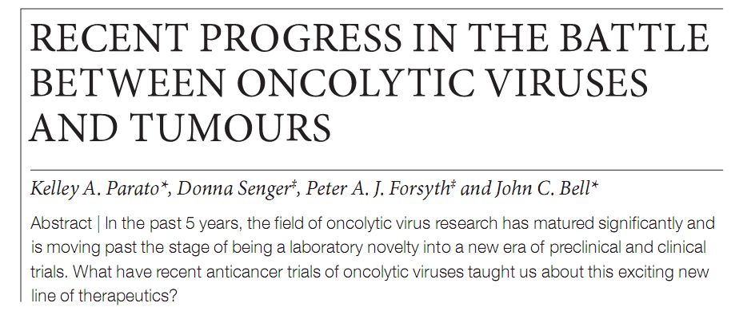

Slide 14
Summary

Slide 15
Infection and killing of tumour cells by an oncolytic virus

Slide 16
About the figure: Infection and killing of tumour cells by an oncolytic virus

Slide 17
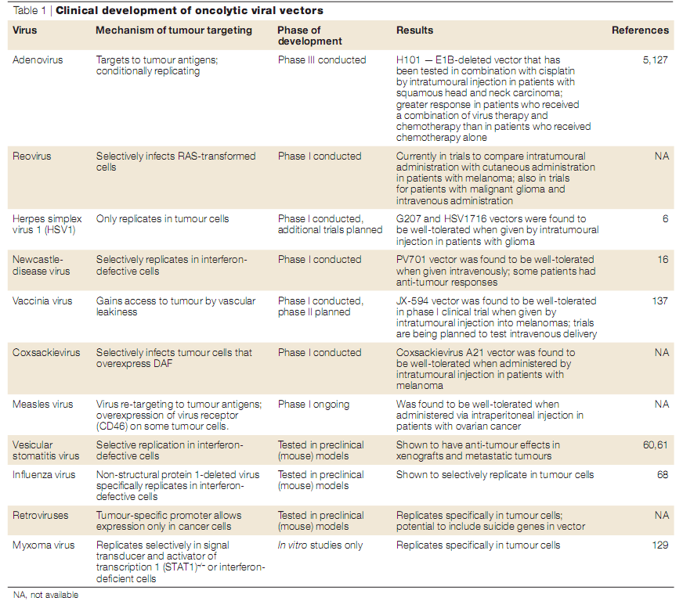

Slide 18
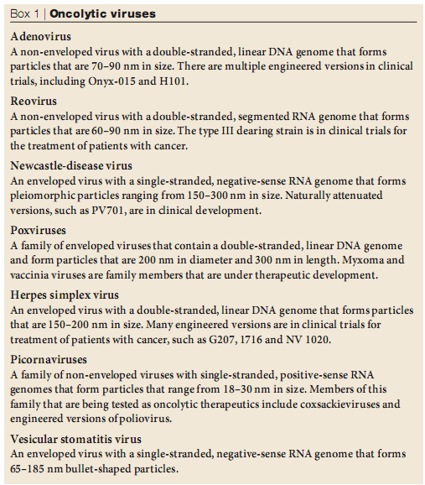
Oncolytic viruses

Slide 19
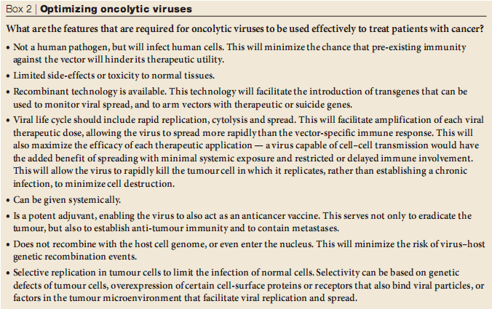
Optimizing oncolytic viruses

Slide 20
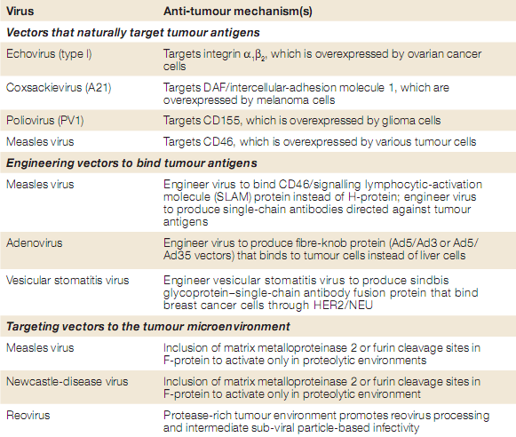
Anti-tumour mechanisms of oncolytic viruses

Slide 21
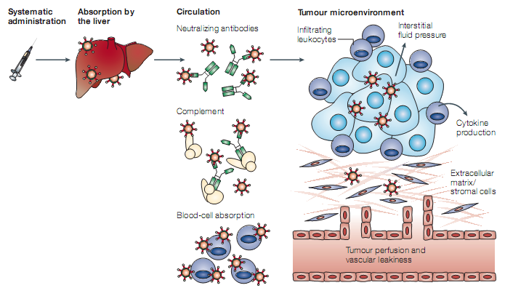
Barriers to optimal delivery of oncolytic viruses to tumours in vivo

Slide 22
Engineered oncolytic viruses: mechanisms-of-actions-
Inherently tumor-selective virus species
Viral gene-deleted mutants
Promoter engineered mutants—viral replication was engineered to be dependent on inserted tumor-speciﬁc promoters
Pseudotyped viruses—normal viral tropism is ablated, and viruses are engineered to attach/bind to speciﬁc surface receptors that are expressed exclusively/preferentially on tumor cells

Slide 23
Question ??

